Slide 1


PLANNING GRAPH
Bhavya-22wh1a6624
Ashritha-22wh1a6626
Nanditha-22wh1a6649

Slide 2
PLANNING GRAPH
A Planning Graph is a data structure primarily used in automated planning and artificial intelligence to find solutions to planning problems. It represents a planning problem’s progression through a series of levels that describe states of the world and the actions that can be taken.
1

Slide 3
LEVELS OF PLANNING GRAPH
Level S0: It is the initial state of the planning graph that consists of nodes each representing the state or conditions that can be true.
Level A0: Level A0 consists of nodes that are responsible for taking all specific actions in terms of the initial condition described in the S0.
Si: It represents the state or condition which could hold at a time i, it may be both P and ¬P.
Ai: It contains the actions that could have their preconditions satisfied at i.
2

Slide 4
WORKING OF PLANNING GRAPH
The planning graph has a single proposition level that contains all the initial conditions. The planning graph runs in stages, each stage and its key workings are described below:
1 . Extending the Planning Graph: At stage i (the current level), the graph plan takes the planning graph from stage i-1 (the previous stage) and extends it by one time step. This adds the next action level representing all possible actions given the propositions (states) in the previous level,
3

Slide 5
followed by the proposition level representing the resulting states after actions have been performed.
2. Valid Plan Found: If the graph plan finds a valid plan, it halts the planning process.
3. Proceeding to the Next Stage: If no valid plan is found, the algorithm determines that the goals are not all achievable in time i and moves to the next stage.
4

Slide 6
MUTUAL EXCLUSION IN PLANNING GRAPH
Mutual exclusion in graph planning refers to the principle that certain actions or propositions cannot coexist or occur simultaneously due to inherent constraints or dependencies within the planning problem. Mutex relations can hold between actions and literals under various conditions.
Mutex Conditions Between Actions:-
Inconsistent Effects: One action negates the effect of another.
Interference: One action deletes a precondition or creates an add-effect of another.
Competing Needs: Precondition of action a and precondition of action b cannot be true simultaneously.
5

Slide 7
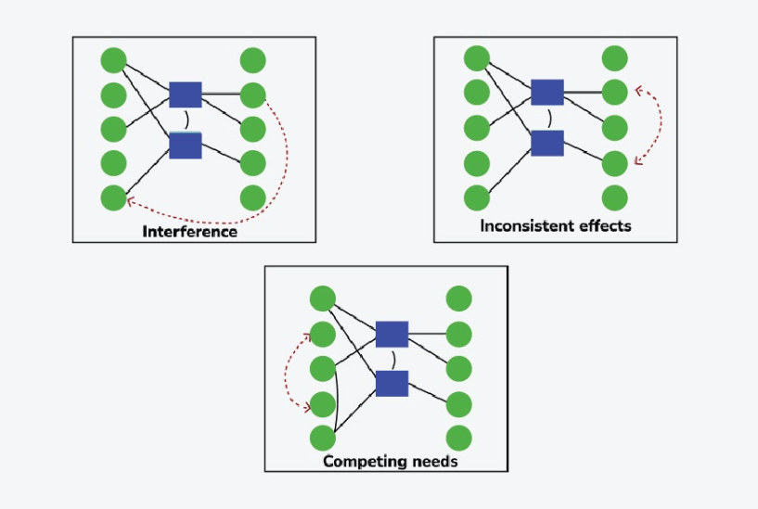
6

Slide 8
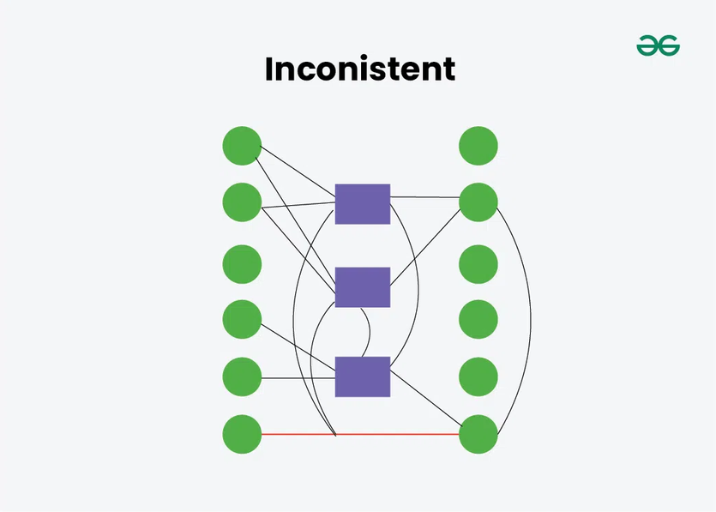
Mutex Conditions Between Literals:-
Negation of Each Other: Two literals are mutually exclusive if one is the negation of the other.
Achieved by Mutually Exclusive Actions: No pair of non-mutex actions can make both literals true at the same level.
7

Slide 9
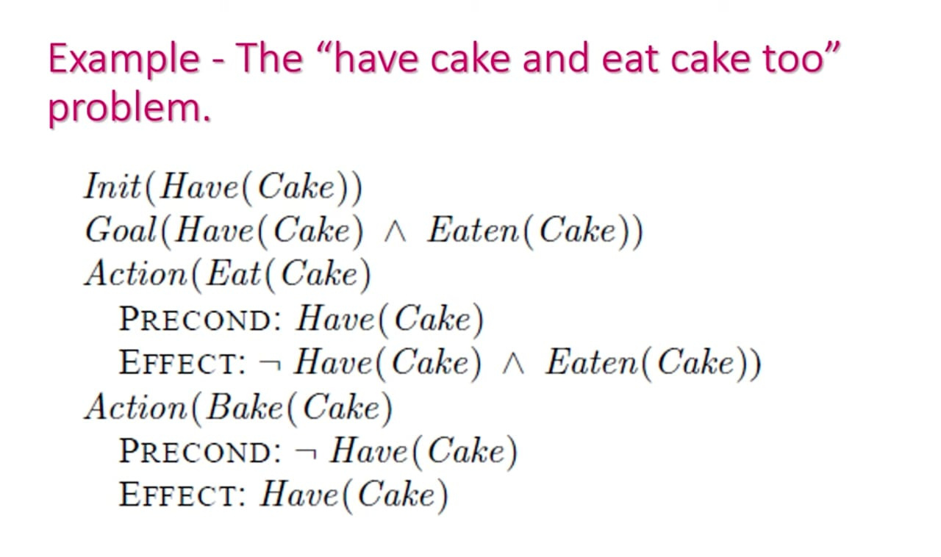
PLANNING A GRAPH FOR A CAKE PROBLEM
8

Slide 10
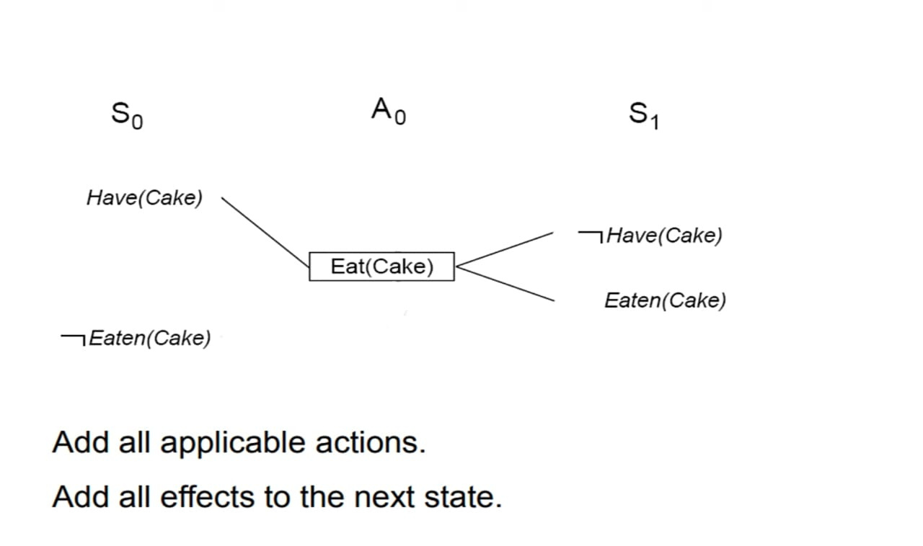
Create Level 0 from initial Problem State.
9

Slide 11
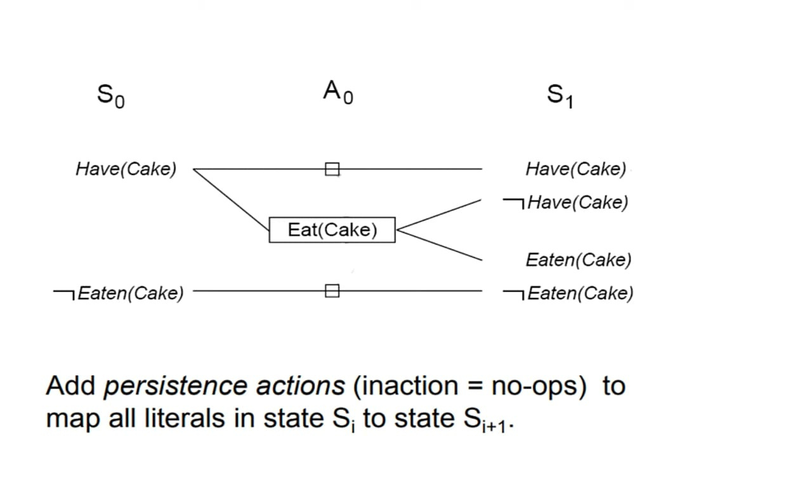
Add all applicable actions and effects to the next State

Slide 12
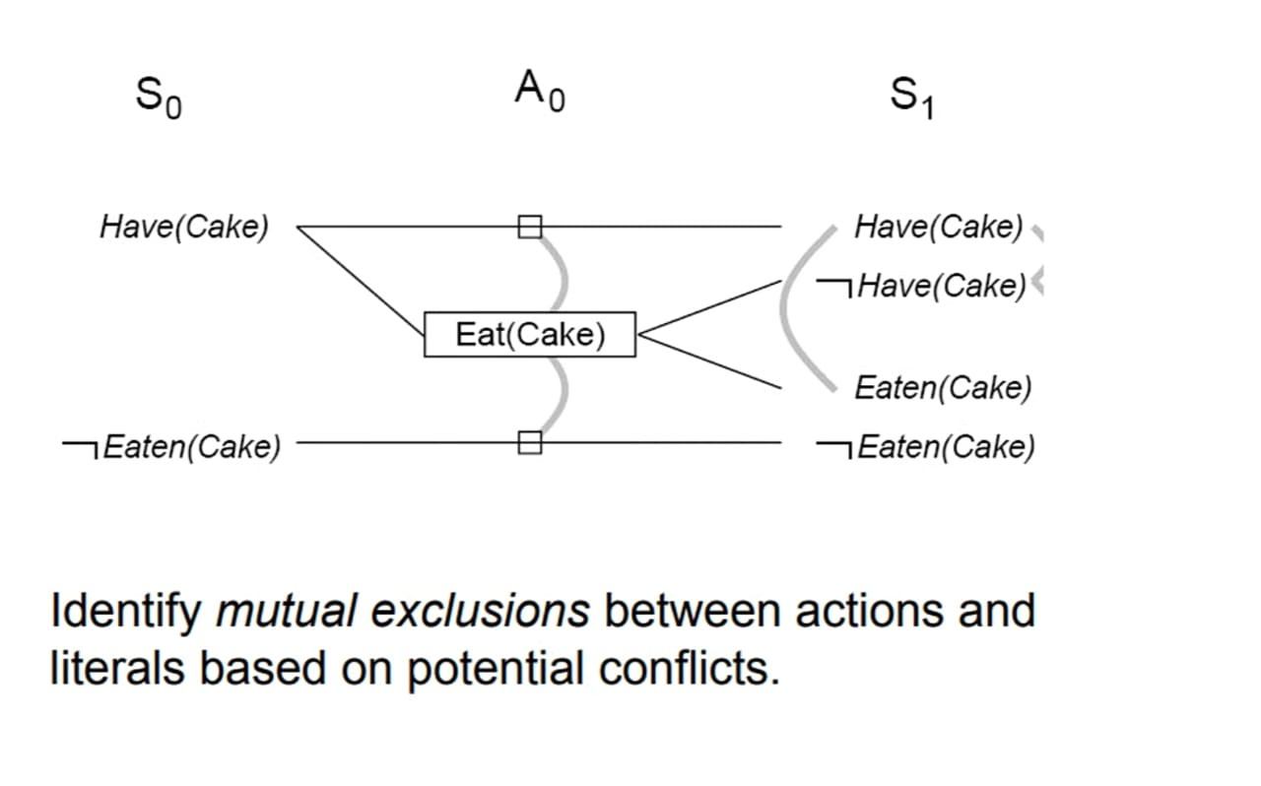

Slide 13
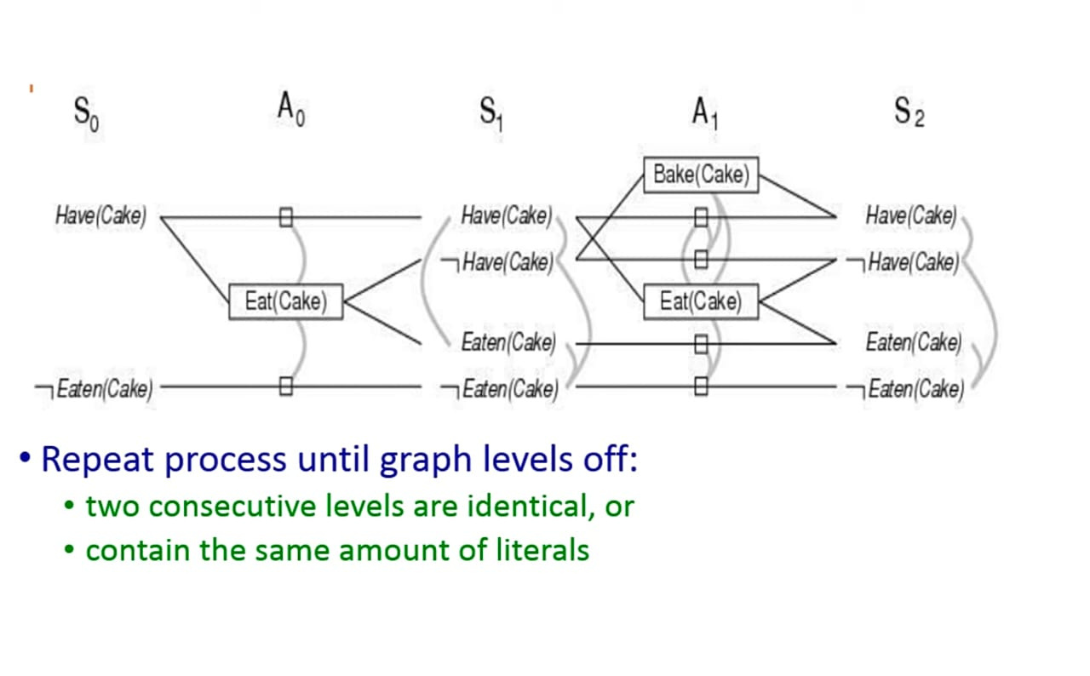

Slide 14
Performance of Mutual Exclusion in Planning Graph
At state level S1, all literals are obtained by considering any subset of actions at A0. In simple terms, state level S1 holds all possible outcomes after the actions in A0 are considered. In our example, since we only have the Eat(Cake) action at A0, S1 will list all possible outcomes with and without the action being taken.
Mutual Exclusion
Mutual exclusion occurs when a conflict arises between literals, indicating that the two literals cannot occur together. These conflicts are represented by mutex links, which reveal mutually exclusive propositions in S1.
For instance, if we eat the cake, we cannot have the cake at the same time. Thus, Have(Cake) and Eaten(Cake) would be mutually exclusive. The mutex links define the set of states, revealing which combinations of literals are not possible together.
For example:
If Eat(Cake) is performed, Have(Cake) and ¬Eaten(Cake) cannot be true simultaneously.
If Eat(Cake) is not performed, ¬Have(Cake) and Eaten(Cake) cannot be true together.

Slide 15
STEPS IN THE GRAPH PLAN ALGORITHM
Your Expand the Planning Graph: The graph is expanded level by level until it reaches level n where all the goals are present and non-mutex.
Check for Plan Existence: If the planning graph levels off before all goals are present and non-mutex, the algorithm fails.
Search for Valid Plan: The algorithm performs a back search from the last level to the initial state to find a sequence of actions leading to the goals without violating mutex constraints.
Expand if No Valid Plan Found: If no valid plan is found, another level is added and the search is repeated until a plan is found or the graph levels off.
10

Slide 16
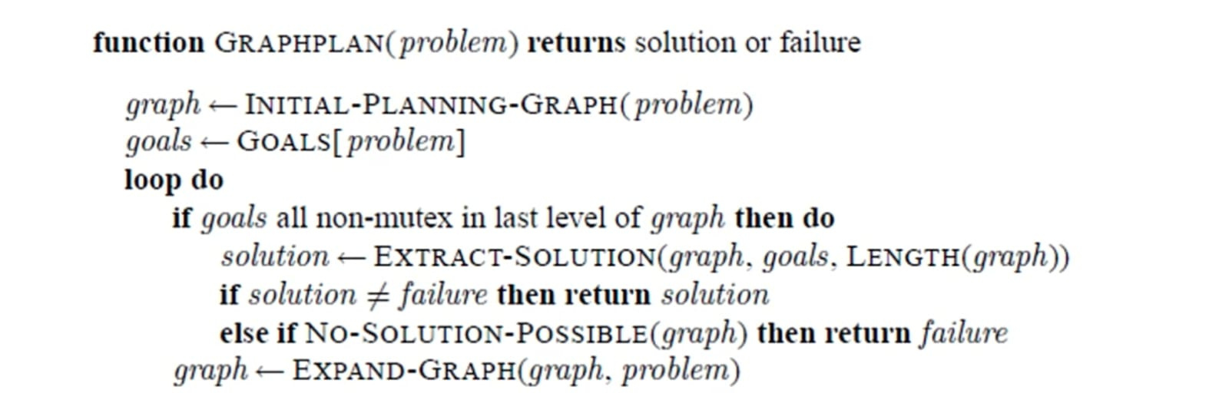

Slide 17
PROPERTIES OF GRAPH PLAN
The elements in the planning graph are described as increasing or decreasing monotonically:
Literals Increase Monotonically
Actions Increase Monotonically
Mutexes Decrease Monotonically
Due to these properties, the presence of a finite number of actions and literals enables the planning graph to eventually level off.
11

Slide 18
CONCLUSION
The graph plan algorithm leverages planning graphs to systematically explore and resolve planning problems. By incorporating mutual exclusion principles, it ensures consistency and feasibility. Through the CAKE example, we have demonstrated how planning graphs efficiently handle complex scenarios.
12

Slide 19

THANK YOU

